Slide 1
Online Banking
Presented by Namkong Hang Kirat Neha Adhikari Ruxana Maharjan Srijal K.C.

Slide 2
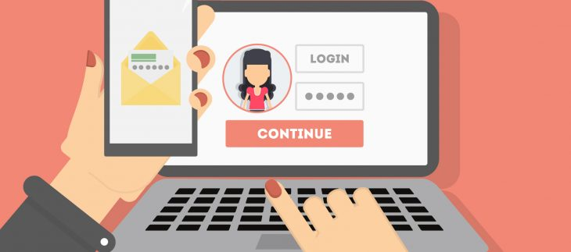
What is Online Banking?
Notes:
Online banking also called internet banking is an electronic payment system that enables customers of a bank or other financial institution to conduct a range of financial transactions through the financial institution's website.
It is an innovative distribution channel under which, customers perform their banking activities over the internet through their personal computer or laptop at a time convenient to them, without having to be restricted to regular branch operating hours.
Online banking is becoming popular as it offers less waiting time and a higher convenience than traditional branch banking with significantly lower cost structure than traditional delivery channels leading to higher levels of customer satisfaction and retention.
As a result, online banking is very attractive to banks and customers, who are now adopting new technologies.

Slide 3

Online Banking in Nepal
Kumari Bank Ltd. was the first bank to start the internet banking in Nepal in 2002.
Study shows that there are 2 Lakhs internet users in Nepal, out of which 50% users are inside Kathmandu Valley.
Notes:
With the establishment of Nepal Bank Ltd. in 1937, the first to start banking in Nepal, banking sector as well as bank customers have to wait nearly about 65 years for online banking.
The Kumari Bank Ltd. was the first bank to start the internet banking in Nepal in 2002.
After 16 years of introduction of online banking, it is still not popular in Nepal. People still rely on Traditional ways of banking.
The major cities like Kathmandu, Pokhara, Biratnagar have good internet facilities and majority of bank provides the internet banking in urban cities.
Study shows that there are about 2 lakh internet users in Nepal, out of which 50% user are inside Kathmandu Valley.
In terms of e-banking, ATM services is adapted by most of the banks in Nepal, while mobile banking getting the popularity but online banking is still not available.

Slide 4

Abroad vs Nepal
Limited information provided
Lack of proper awareness programmes
Weak security
Not proper skilled manpower
Bad internet
Notes:
With the establishment of Nepal Bank Ltd. in 1937, the first to start banking in Nepal, banking sector as well as bank customers have to wait nearly about 65 years for online banking.
The Kumari Bank Ltd. was the first bank to start the internet banking in Nepal in 2002.
After 16 years of introduction of online banking, it is still not popular in Nepal. People still rely on Traditional ways of banking.
The major cities like Kathmandu, Pokhara, Biratnagar have good internet facilities and majority of bank provides the internet banking in urban cities.
Study shows that there are about 2 lakh internet users in Nepal, out of which 50% user are inside Kathmandu Valley.
In terms of e-banking, ATM services is adapted by most of the banks in Nepal, while mobile banking getting the popularity but online banking is still not available.

Slide 5
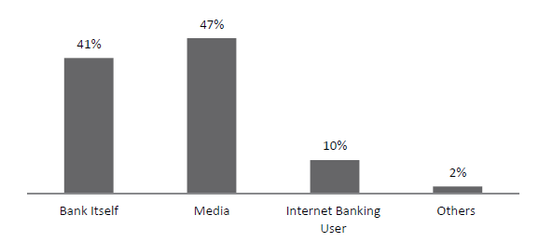
Sources of knowledge about Online Banking
Research by Jyoti Raj Khatri (Think Tank Foundation, Kathmandu)
Notes:
Figure shows the source of respondents’ knowledge about internet banking.
Of 85% who have heard about the internet banking, 47% have heard from the media (television, radio, or newspaper), and 41% have got the information from the bank itself.
Similarly, 10% of the respondents have got the information from other users of internet banking.

Slide 6
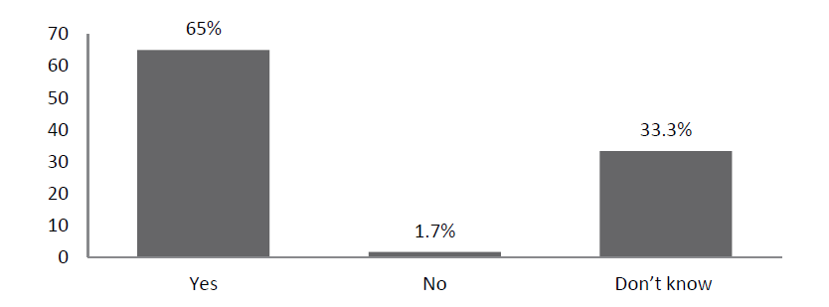
Knowledge of internet banking service
Research by Jyoti Raj Khatri (Think Tank Foundation, Kathmandu)
Notes:
Figure shows percentage of respondent with the knowledge about internet banking services provided by their bank.
It clearly suggests that majority of the respondents i.e. 65% know that their bank provide the internet banking facilities but around 33% of the respondents do not know or have no knowledge whether their bank provide the internet banking service or not.
Less than 2% have said their bank does not provide the internet banking service.

Slide 7

Online Banking services in Nabil Bank
1. Nabil Net
Utility bill payments.
Account to account fund transfer within bank.
Balance inquiry, account statement.
2. Nabil e-secure
One Time Password (OTP) to protect online transaction.
Simple registration.
Secure e-commerce transaction.

Slide 8

Continued..
3. Nabil Smart Bank
Dual Channel Access (Internet/SMS)
Credit Card Bill Payments
Recharge Cards viz. NTC prepaid, Dish Home, Broadlink
Load eSewa Wallets
Account balance Enquiry, Mini Statement, Cheque Book Request, Full Statement Request

Slide 9
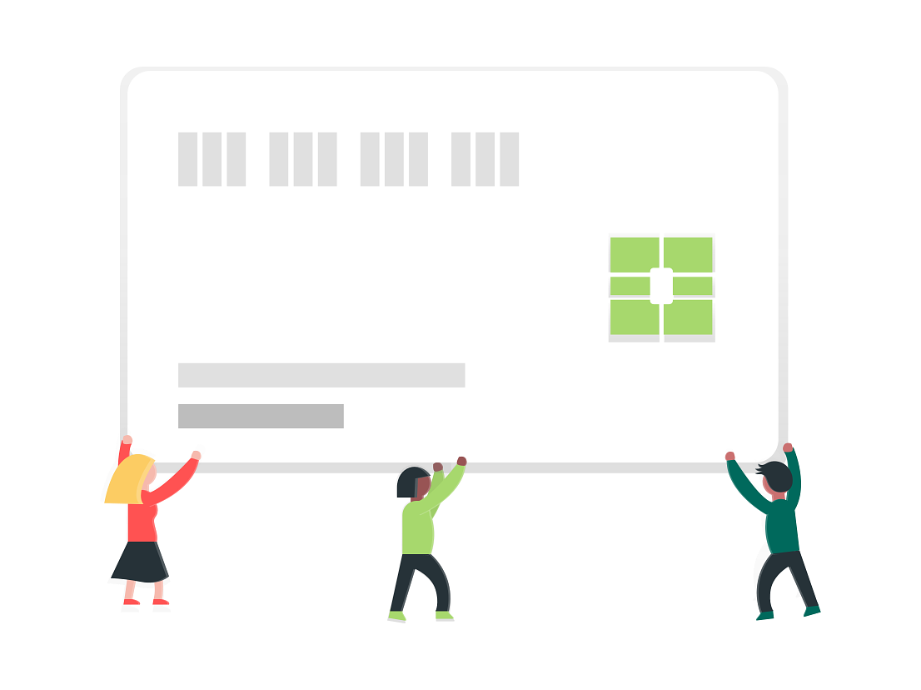
Continued..
4. Nabil Electronic Payment Gateway
Customers can pay with all major card brands i.e. Visa, MasterCard and UnionPay International.
Supports 3D Secure service of Visa, MasterCard & UnionPay International
Online fraud management tool
Virtual terminal access

Slide 10
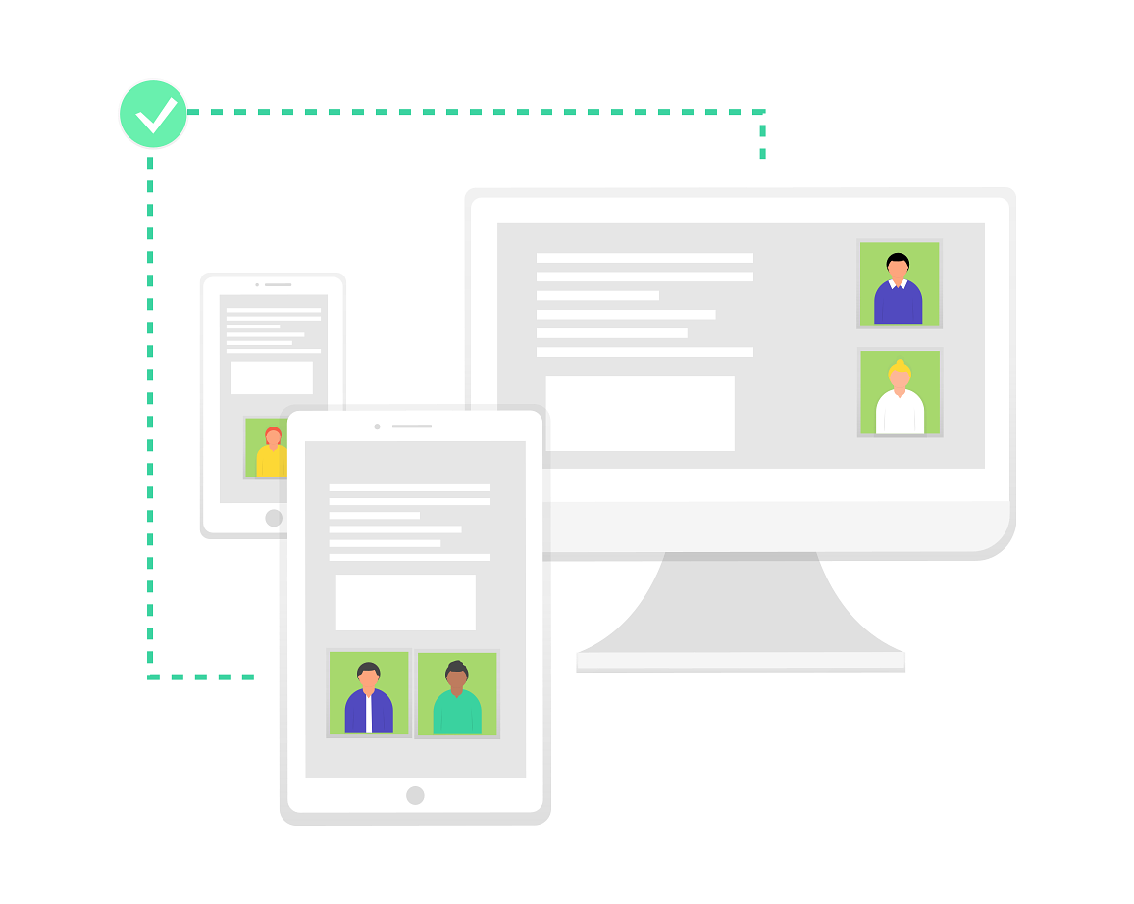
Continued..
5. Nabil Viber Banking
Direct interaction with the bank with the help of Viber messaging app.
6. Nabil Online
Online payment service.
Cheapest and convenient.
Faster and reliable.
Hassle free documentation.
Notes:
ViberBanking is a digital technology that allows you to enjoy various services by interacting with the Bank directly through Viber, the popular internet based cross-platform instant messaging and voice over IP (VoIP) application, available for free from Google Play Store and App Store.
NABILONLINE is an electronic payment solution where your registrations become easier and your payment confirmation is received immediately upon execution of online payment.

Slide 11
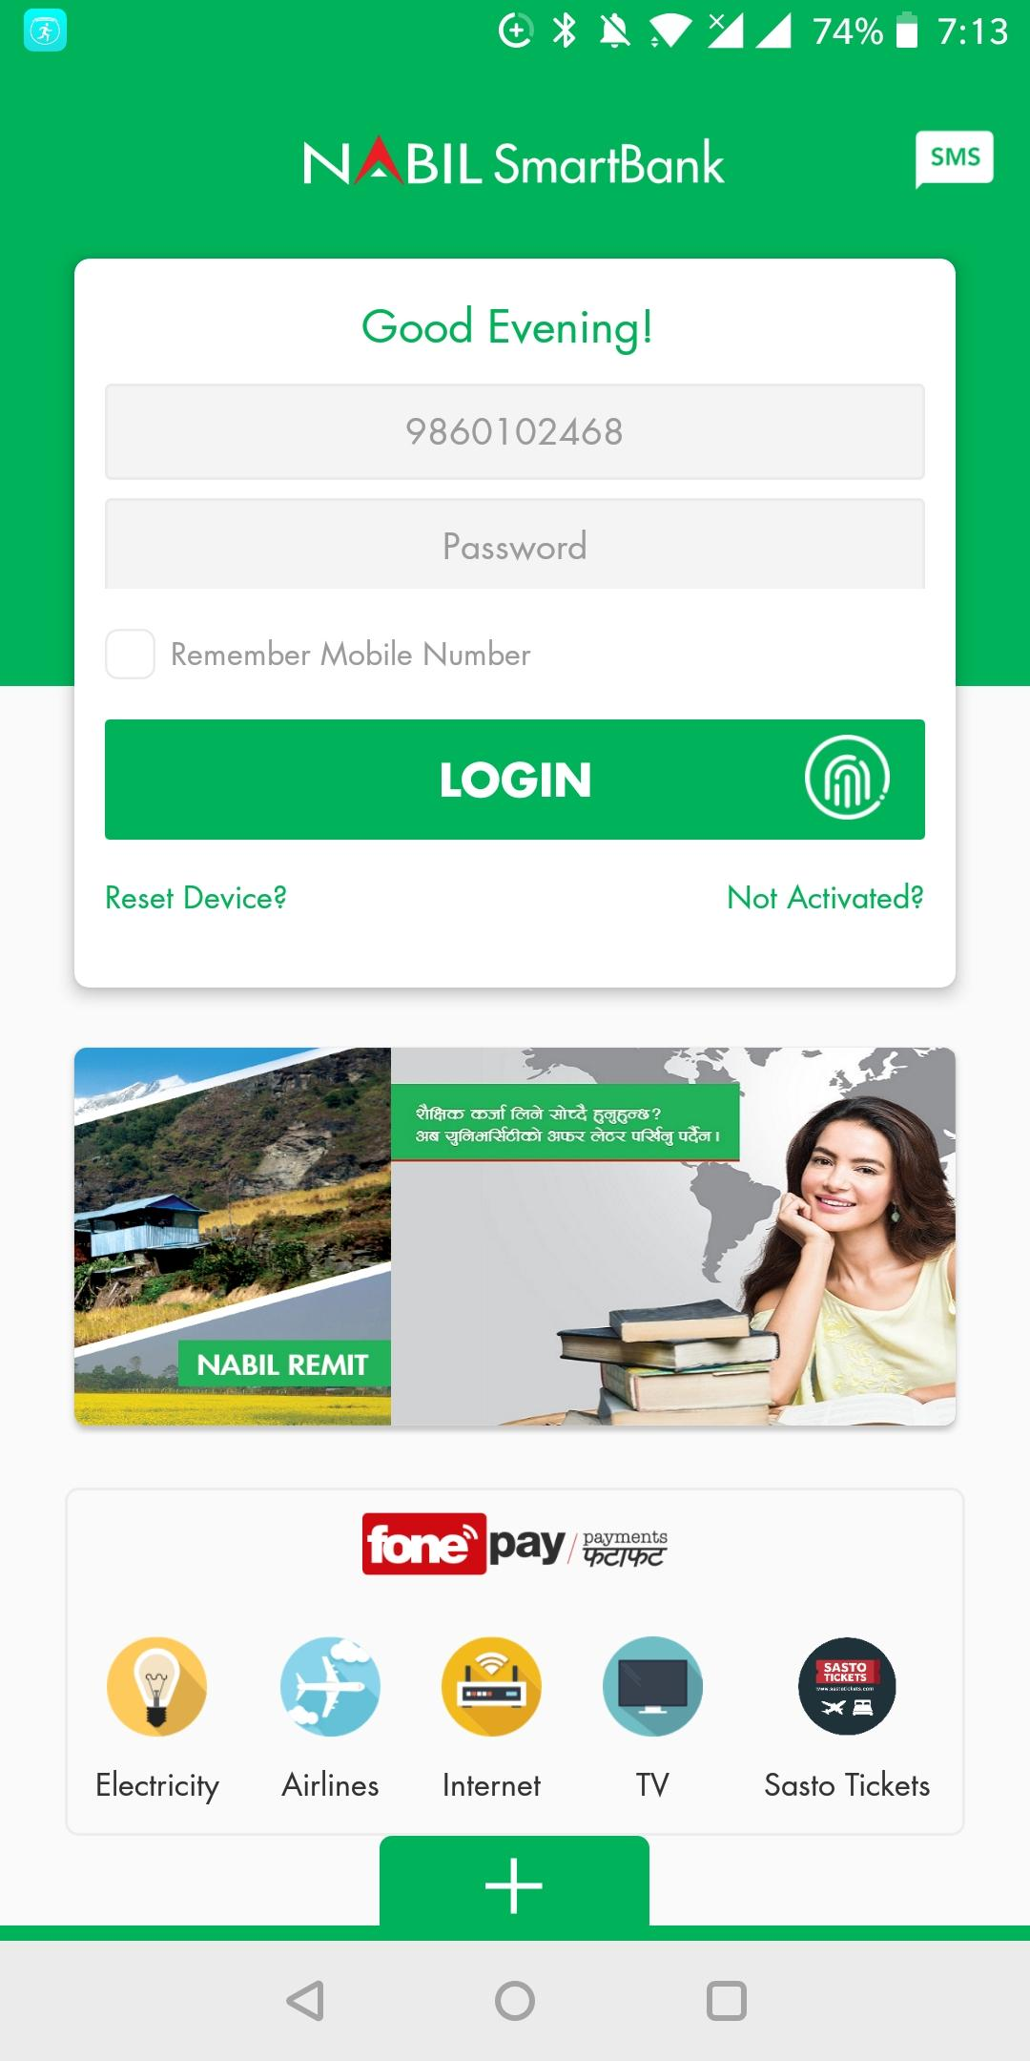
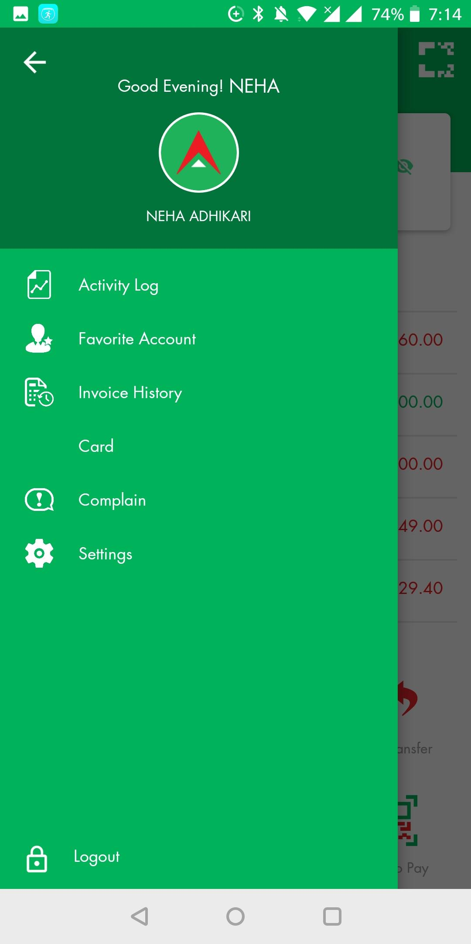
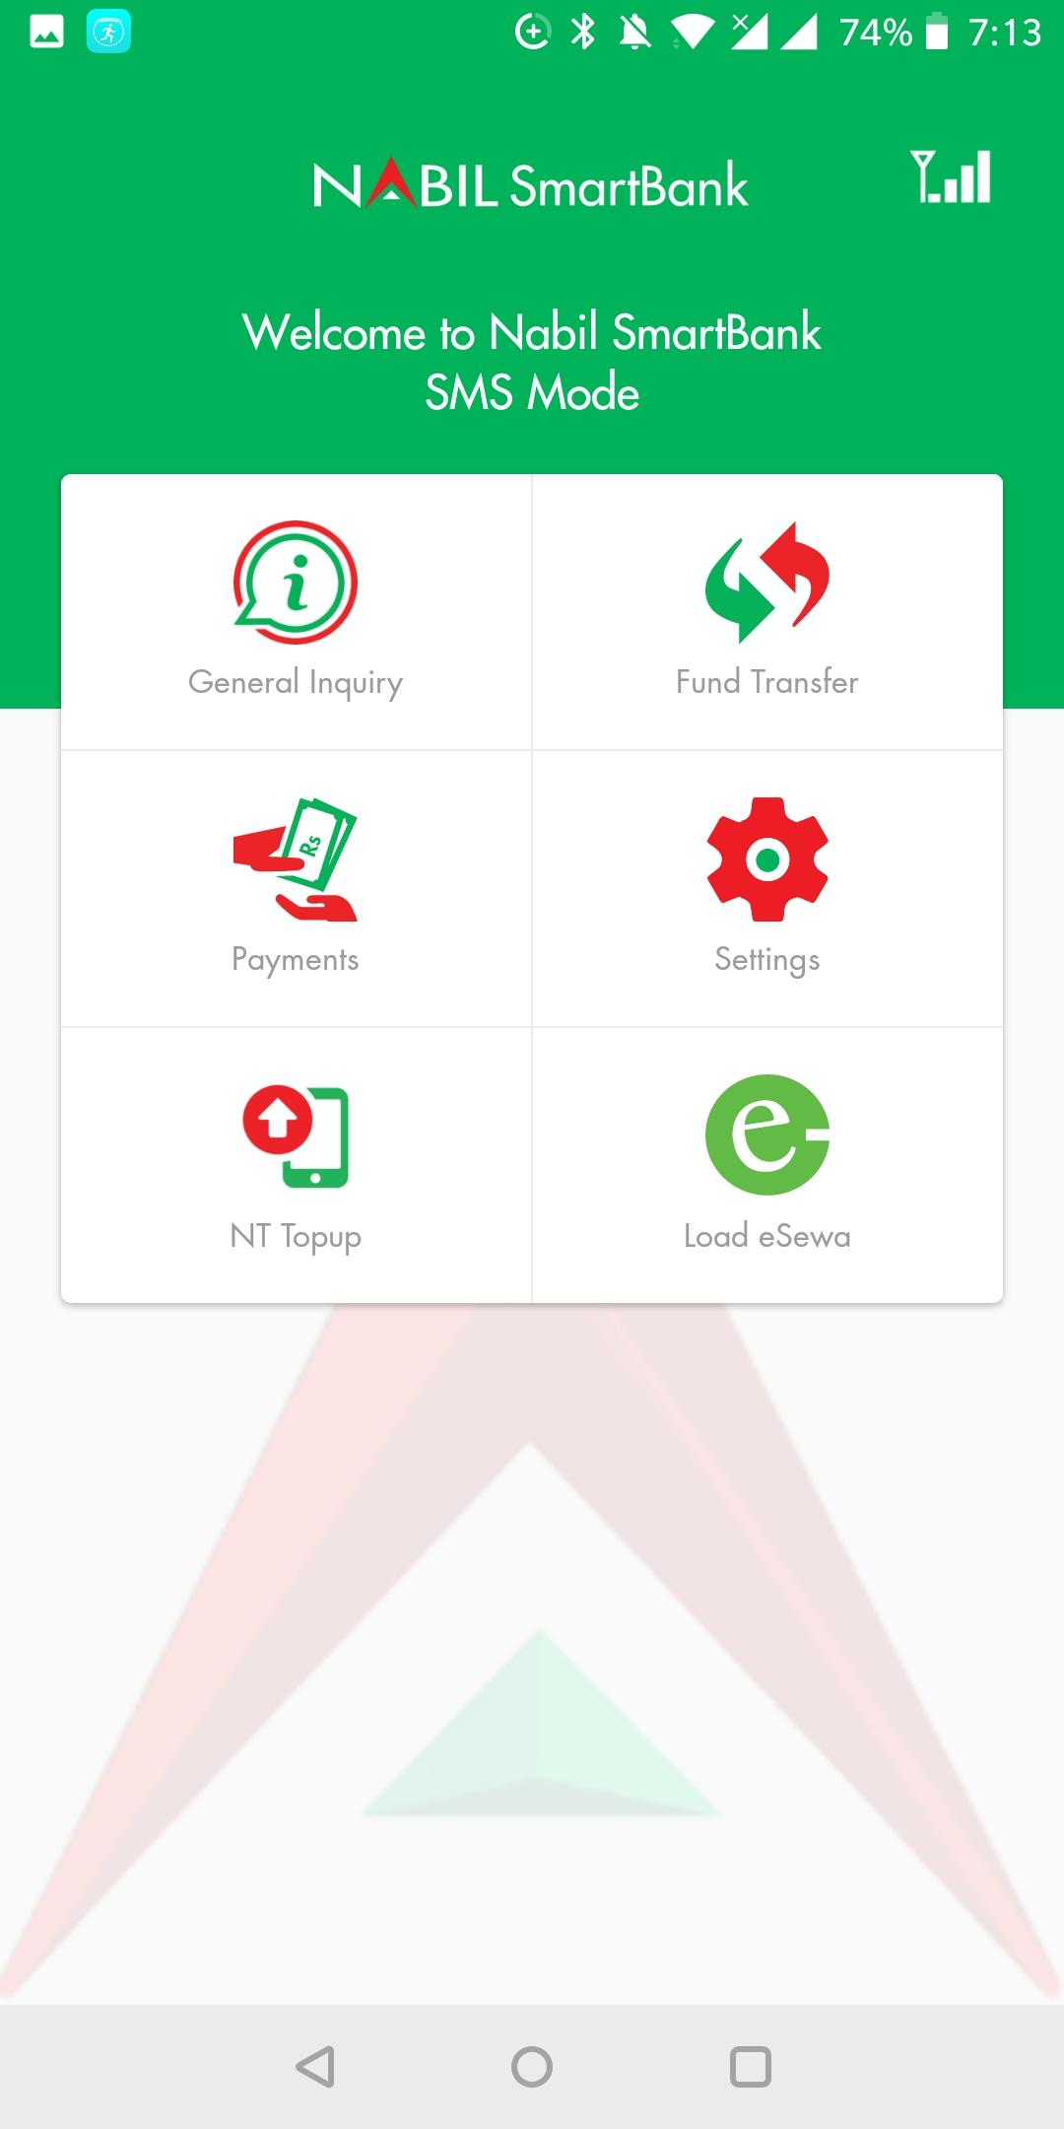
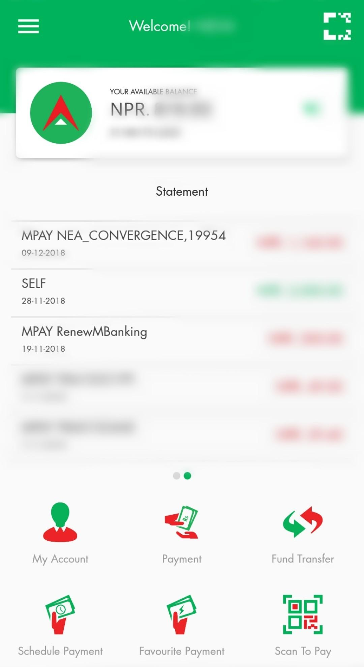
Screenshots

Slide 12

Challenges
Not familiar with online banking technology
Banking website not trustworthy
Lack of information about internet banking
Not regular banking activities
Internet Infrastructure in the country
Customers knowledge about internet
Notes:
Obtaining the account information and paying the utility bills are main component included in the online banking services.
Customer’s knowledge about the internet and its application, awareness, concerns about the security, infrastructure, and resources are major barrier faced by the bank for the development and widespread coverage of internet banking technology.
On the other hand, although the customers are aware about the internet banking services but they are not attracted towards utilizing it for their day to day transactions.
Banks fail to provide the proper information about the use, benefits, and facilities under online banking.
Hence, the banks should educate and encourage their customers for using online banking.

Slide 13
THANK YOU

